Slide 1

 | S.S.V.P.S’s B. S. Deore Polytechnic, Dhule Department of Computer Engineering Academic Year : 2026-2027
SEMINAR AND PROJECT INITIATION COURSE
Sem: CO 5 K |  | SPI – 315003 | Date:
Topic: Smart Power Management
Roll No. |  | Name of Student
24 |  | Nagarale Dakshyani Kiran
27 |  | Harwani Aryan Shankar
28 |  | Jadhav Chaitanya Suresh
31 |  | Kamble Meghana Manoj

Slide 2
Contents
Abstract
Introduction
Literature Review
Information to Seminar Topic
Advantages and Disadvantages
Conclusion
Project Initiation:
6. 1 Description of Problem Statement
6. 2 Scope and Objectives
6. 3 Stakeholder
6. 4 Seminar Discussion Plan
6. 5 Platform/ Equipment/ Resources Identification.
Bibliography
References

Slide 3
Abstract
Smart Power Management is an efficient approach to monitoring and controlling electricity consumption. Traditional power management systems may lead to unnecessary energy wastage due to a lack of real-time monitoring and automated control. The proposed system uses sensors, microcontrollers, smart meters, and IoT technology to monitor power consumption and optimize electricity usage.
It aims to reduce energy wastage, lower electricity costs, and improve energy efficiency, promoting sustainable power utilization.

Slide 4
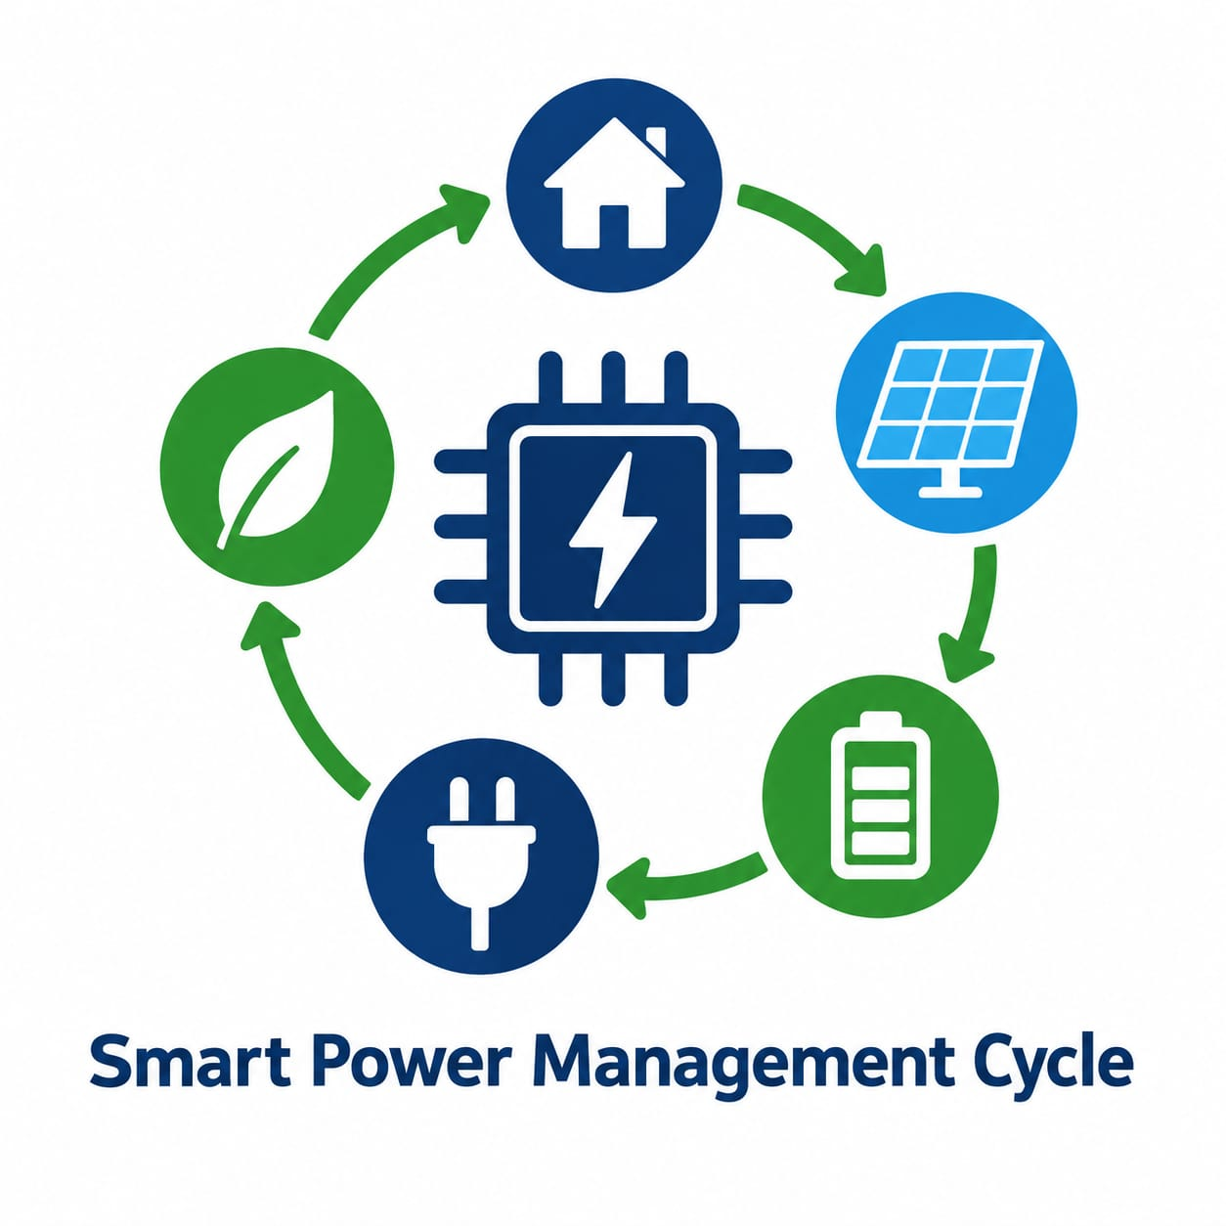
1. Introduction
Smart Power Management is a technology-driven approach to monitor and control electricity consumption efficiently.
It uses sensors, microcontrollers, smart meters, and IoT technology to track power usage.
It helps manage electrical appliances and reduce unnecessary energy wastage.
The system aims to lower electricity costs and improve energy efficiency.
It promotes sustainable and responsible utilization of electrical power.

Slide 5
2. Literature Survey
Sr. No. | Approach Type | Technologies Used | Dataset | Key Objective | Limitations
1 | IoT and Big Data Analytics | IoT, wireless communication, data acquisition modules, centralized server, Big Data analytics | Residential HVAC energy consumption data | To monitor electricity consumption and control appliances remotely. | Requires reliable internet, additional hardware, data storage and security.
2 | IoT-Based Load Management | IoT, programmable load categorization, appliance scheduling, Time-of-Day tariffs | Indian residential electricity consumption and usage patterns | To reduce peak electricity demand and electricity bills through smart load scheduling. | Savings depend on appliance usage, electricity tariffs and user acceptance.
3 | Real-Time IoT-Based Energy Management | IoT, smart plugs, load scheduling, mobile application, MMGO optimization algorithm | Energy consumption data from a single dwelling and a cluster of 50 homes | To reduce electricity costs and peak demand while maintaining user convenience. | Requires connected hardware, accurate energy data and complex scheduling algorithms.

Slide 6
Sr. No. | Approach Type | Technologies Used | Dataset | Key Objective | Limitations
4 | ML-Based Smart Home Energy Management | LSTM, Machine Learning, Smart Meters, Cloud Computing | Household appliance energy data recorded at 1-minute intervals for 350 days. | To predict household energy consumption and improve energy efficiency. | Prediction errors and dependence on data quality.
5 | IoT and Big Data-Based Energy Management | IoT, J48 Algorithm, Weka, Apache Mahout, RuleML | Smart home energy consumption and user behavior data. | To classify energy usage and recommend energy-saving actions while maintaining comfort and safety. | Security concerns and challenges in managing large amounts of data.
6 | Reinforcement Learning-Based Energy Management | Q-Learning, Artificial Neural Network (ANN), Solar PV, Energy Storage System | Simulated data for a home with solar PV, an air conditioner, a washing machine, and energy storage. | To schedule appliances and battery operation to reduce electricity bills while maintaining comfort. | Tested through simulation for a single home; performance depends on comfort settings and operating conditions.

Slide 7
Sr. No. | Approach Type | Technologies Used | Dataset | Key Objective | Limitations
7 | AI-Based Sustainable Energy Management | Machine Learning, Deep Learning, Energy Forecasting | Data from over 200 reviewed research studies | To predict electricity demand and improve energy efficiency. | Data quality issues and limited real-world implementation.
8 | AI and IoT Home Energy Management | AI, IoT, Solar PV, Energy Storage | Household energy consumption data | To optimize appliance scheduling and reduce electricity costs. | Cybersecurity risks and device compatibility issues.
9 | Machine Learning-Based Energy Management | IoE, SVM, Cloud Storage, Data Preprocessing | 757 energy-management records | To predict energy-management requirements and reduce energy wastage. | Requires computing resources and further real-world testing.

Slide 8
Sr. No. | Approach Type | Technologies Used | Dataset | Key Objective | Limitations
10 | Occupancy-Based Power Management | Raspberry Pi, Python, CNN, Sensors, Relays | Room occupancy and sensor readings | To automatically control appliances and reduce electricity wastage. | Sensor errors and privacy concerns.
11 | IoT-Based Solar Energy Management | IoT, Solar PV, Sensors, Cloud Computing | Solar voltage, current, and energy-output data | To monitor solar power and improve energy management. | High initial cost, connectivity issues, and security risks.
12 | IoT-Based Energy Monitoring | Smart Meters, NodeMCU, Wi-Fi, Cloud Software | Real-time and historical electricity consumption data | To monitor electricity usage and identify energy wastage. | Depends on connectivity and suitable hardware.

Slide 9
3. Information to Seminar Topic
Technology: Internet of Things (IoT), Sensors, Microcontrollers and Smart Energy Monitoring.
Main purpose: To monitor and manage electricity consumption efficiently and reduce unnecessary energy wastage.
Key concept: Real-time monitoring of power usage and efficient control of electrical appliances.
Approach: Uses sensors, smart meters and microcontrollers to monitor electricity consumption and support better energy management.
Main benefit: Reduces energy wastage, lowers electricity costs and improves energy efficiency.
Applications: Smart homes, offices, colleges, industries, hospitals and commercial buildings.

Slide 10
4. Advantages / Disadvantages
Advantages:
Reduces unnecessary electricity consumption.
Helps lower electricity bills.
Monitors power usage in real time.
Supports automatic control of electrical appliances.
Promotes energy conservation and sustainability.
Disadvantages:
Requires high initial installation costs.
Depends on internet connectivity for IoT features.
Requires regular maintenance.
May face cybersecurity and data privacy risks.
Requires technical knowledge for installation and troubleshooting.

Slide 11

5. Conclusion
Smart Power Management is an effective approach to monitoring and managing electricity consumption. It uses smart technologies to identify energy usage, reduce unnecessary wastage, and improve the efficiency of electrical appliances. It also helps lower electricity bills and supports better power utilization. Overall, Smart Power Management promotes energy conservation, reduces environmental impact, and contributes to a smarter and more sustainable future.

Slide 12
6. Project Initiation
The Smart Power Management project was developed to address the problem of unnecessary electricity consumption and energy wastage in homes, offices, and other buildings. Traditional power management methods may not provide efficient real-time monitoring and control of electricity usage.
The project aims to monitor power consumption using smart meters, sensors, microcontrollers, and IoT technology. It helps identify unnecessary energy usage and supports efficient management of electrical appliances. As a result, the system aims to reduce electricity bills, improve energy efficiency, and promote energy conservation for a smarter and more sustainable future.

Slide 13
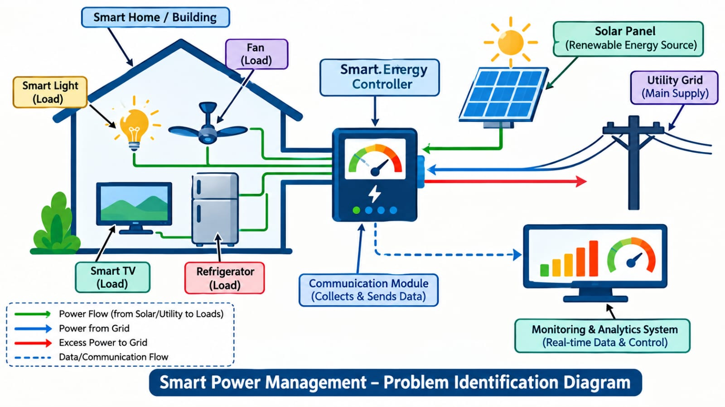
6. 1 Description of Problem Statement.
Identification.
Smart Power Management aims to address electricity wastage caused by the lack of real-time monitoring and efficient control of power consumption. Traditional methods make it difficult to identify unnecessary energy usage and manage appliances effectively. The proposed system focuses on monitoring electricity consumption, identifying wastage, and improving energy efficiency.

Slide 14
6. 2 Scope and Objectives
Objectives:
Monitors electricity consumption in real time.
Identifies unnecessary power usage and reduces energy wastage.
Improves the efficiency of electrical appliances.
Reduces electricity bills through effective power management.
Promotes energy conservation and sustainable electricity usage.
Scope:
Applicable in homes, offices, colleges, and industries.
Real-time monitoring of power consumption using smart meters and sensors.
Integration of microcontrollers and IoT technology for efficient power management.
Remote monitoring and automatic appliance control, where implemented.
Future integration with renewable energy sources and smart grid technologies.

Slide 15
6. 3 Stakeholder
Homeowners:
Monitor electricity usage and reduce electricity bills.
Building Managers:
Manage power consumption in offices, colleges, and commercial buildings.
Electricity Providers:
Analyze energy consumption and support efficient power distribution.
Industries:
Reduce energy wastage and improve operational efficiency.
System Administrators:
Maintain the system, monitor performance, and manage connected devices.

Slide 16
6. 4 Seminar Discussion Plan
1. Current Scenario: Increasing electricity consumption creates a need for smart power management systems.
2. Energy Challenges: Uncontrolled power usage causes energy wastage and higher electricity bills.
3. Existing Approaches: Smart meters and IoT-based systems help monitor and control electricity consumption.
4. Research Gap: Efficiently identifying and reducing unnecessary power consumption remains a challenge.
5. Proposed Solution: The proposed system monitors electricity usage and helps minimize power wastage.
6. Expected Impact: Better power management can reduce costs and improve energy efficiency.
7. Future Work: AI prediction and renewable energy integration can make the system more efficient.

Slide 17
6.5 Platform/ Equipment/ Resources
1. Development Platform
Windows-based computer for system development.
Programming environment for processing and analyzing energy data.
IoT platform for monitoring electricity consumption.
2. System Equipment
Sensors and smart meters to collect power usage data.
Arduino or ESP32 microcontroller to process sensor readings.
Wi-Fi module or connectivity for transferring data.
3. Supporting Resources
Electrical appliances for system testing.
Sample energy consumption data for analysis.
Testing tools to evaluate monitoring accuracy and system performance.

Slide 18
Bibliography
Books
1) Internet of Things: A Hands-On Approach — Arshdeep Bahga and Vijay Madisetti.
2) Building Automation: Control Devices and Applications — Phil Zito.
3) Internet of Things: Architecture and Design — Raj Kamal.
4) Energy Management Handbook — Wayne C. Turner and Steve Doty.
Websites
1) Arduino Official Website — www.arduino.cc
2) Espressif ESP32 Documentation — docs.espressif.com
3) MDPI Research Publications — www.mdpi.com
4) U.S. Department of Energy — www.energy.gov

Slide 19
References
1. Filho, G.P.R.; Villas, L.A.; Gonçalves, V.P.; Pessin, G.; Loureiro, A.A.F.; Ueyama, J. Internet of Things Energy-efficient smart home systems: Infrastructure and decision-making process. Internet Things 2019, 5, 153–167. [CrossRef]
2. Thema, J.; Suerkemper, F.; Couder, J.; Mzavanadze, N.; Chatterjee, S.; Teubler, J.; Thomas, S.; Ürge-Vorsatz, D.; Hansen, M.B.; Bouzarovski, S.; et al. The multiple benefits of the 2030 EU energy efficiency potential. Energies 2019, 12, 2798. [CrossRef]
3.Mosavi,A.;Salimi,M.;Ardabili,S.F.;Rabczuk,T.;Shamshirband,S.;Varkonyi-Koczy,A.R.Stateoftheartof machinelearningmodelsinenergysystems,asystematicReview.Energies2019,12,1301. [CrossRef]
4.Nejat,P.;Jomehzadeh,F.;Taheri,M.M.;Gohari,M.;Majid,M.Z.A.Aglobalreviewofenergyconsumption, CO2emissionsandpolicyintheresidentialsector(withanoverviewofthetoptenCO2emittingcountries). Renew.Sustain.EnergyRev.2015,43,843–862. [CrossRef]
5. Baig F, Beg S, Khan MF. Controlling home appliances remotely through voice command. arXiv. 2012. https:// doi. org/ 10. 48550/ arXiv. 1212. 1790.
6. Kaluri R, Rajput DS, Xin Q, Lakshmanna K, Bhattacharya S, Gadekallu TR, Maddikunta PKR. Roughsets-based approach for predicting battery life in IoT. arXiv. 2021. https:// doi. org/ 10. 48550/ arXiv. 2102. 06026.
7. A. Khalil, N. Mbarek and O. Togni, “Fuzzy logic based model for self-optimizing energy consumption in IoTenvironment,”in 2021IEEEWirelessCommunicationsandNetworkingConf.,Nanjing,China,pp.1–7, 2021.

Slide 20
References
8. A.R.Jordehi, M.S.JavadiandJ.P.Catalão,“Energymanagementinmicrogridswithbatteryswapstations and var compensators,”Journal of Cleaner Production, vol. 272, no. 1, pp. 29–43, 2020.
9. S.K. Das, D. Cook, A. Bhattacharya, E.O. Heierman, T.Y. Lin, The role of prediction algorithms in the mavHome smart home architecture, IEEE Wireless Commun. Mag. 9 (2002), 77–84.
10. M. S. Saleh, A. Althaibani, Y. Esa, Y. Mhandi, and A. A. Mohamed, "Impact of clustering microgrids on their stability and resilience during blackouts," Oct. 2015, doi: 10.1109/ICSGCE.2015.7454295.
11. M. Raval, S. Bhardwaj, A. Aravelli, et al., Smart energy optimization for massive IoT using artificial intelligence, Internet Things 13 (2021). [3]
12. T. Ahmad, D.D. Zhang, Using the Internet of Things in smart energy systems and networks, Sustain. Cities Soc. 68 (2021).
13.A.K.M.Masum,M.K.A.Chy,M.T.HasanandM.H.Sayeed,“Smartmeterwithloadpredictionfeature for residential customers in Bangladesh,” in Int. Conf. on Energy and Power Engineering, Bangladesh, pp. 1–6, 20
14. Rathore, M.M.; Paul, A.; Ahmad, A.; Rho, S. Urban planning and building smart cities based on the Internet of Things using Big Data analytics. Comput. Netw. 2016, 101, 63–80. [CrossRef]
15. Kumar A, Singh AR, Deng Y, He X, Kumar P, Bansal RC (2018) Multiyear load growth based techno-financial evaluation of a microgrid for an academic institution. IEEE Access 6:3753337555. https:// doi. org/ 10. 1109/ ACCESS. 2018. 28494 11

Slide 21
Thank you

